Slide 1


Slide 2
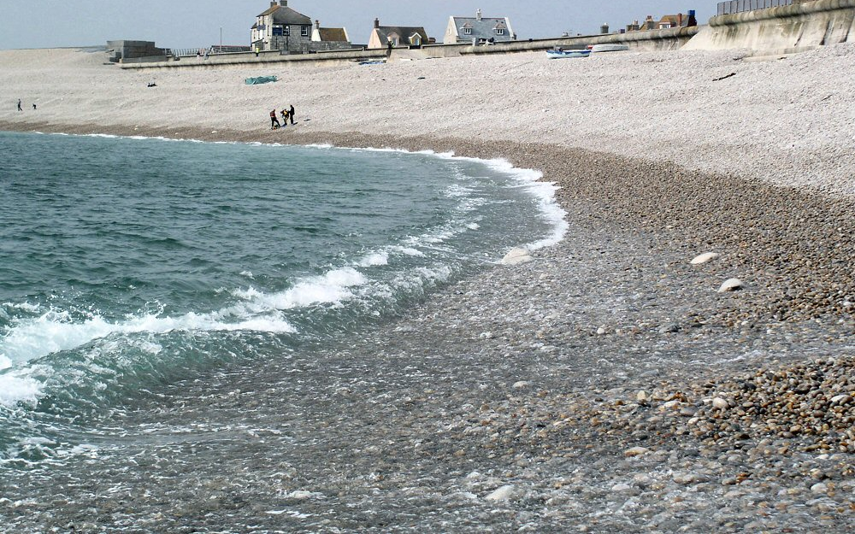
backwashes
noun- a backward flow or movement (as of water or air)

Slide 3

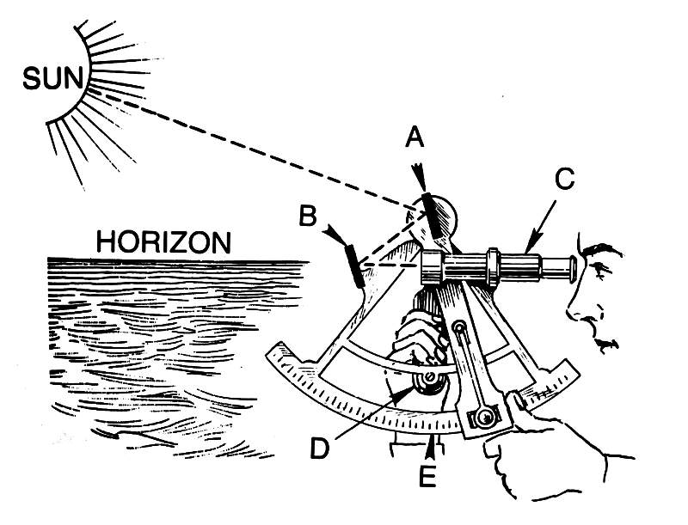
navigation
noun- the science of getting ships, aircraft, or spacecraft from place to place (especially position, course, and distance traveled)

Slide 4

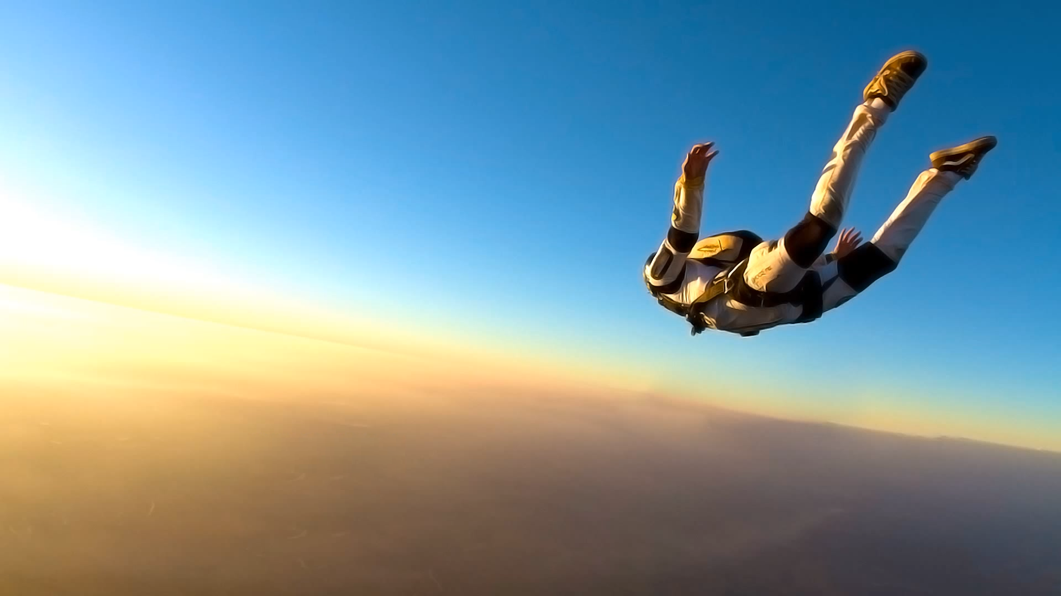

enterprise
noun- the ability or desire to do dangerous or difficult things or to solve problems in new ways

Slide 5

phosphorescent
adjective- of or relating to a type of light that glows softly in the dark and that does not produce heat

Slide 6

luminous
adjective- producing or seeming to produce light

Slide 7
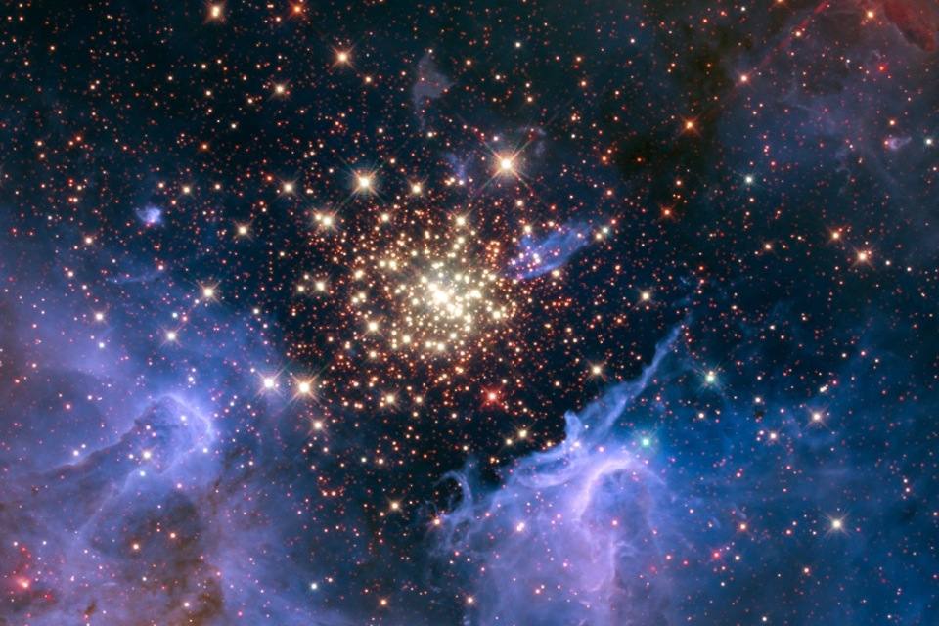
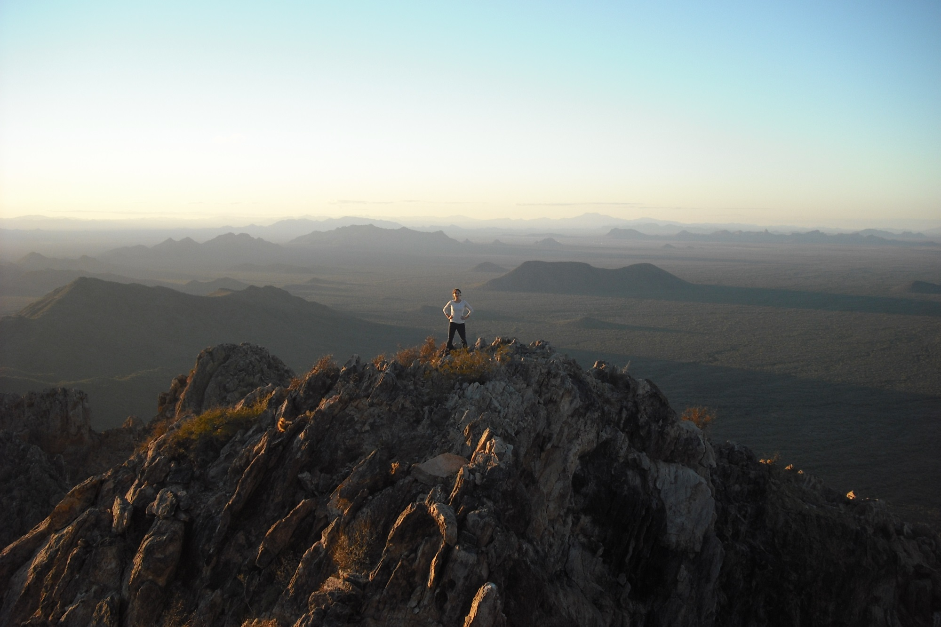
vast
adjective- very great in size, amount, or extent

Slide 8
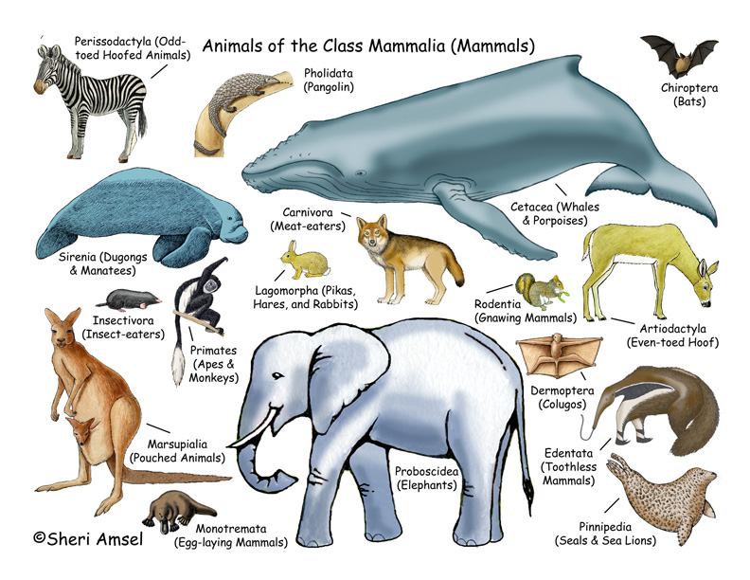
mammal
noun- a type of animal that feeds milk to its young and that usually has hair or fur covering most of its skin

Slide 9
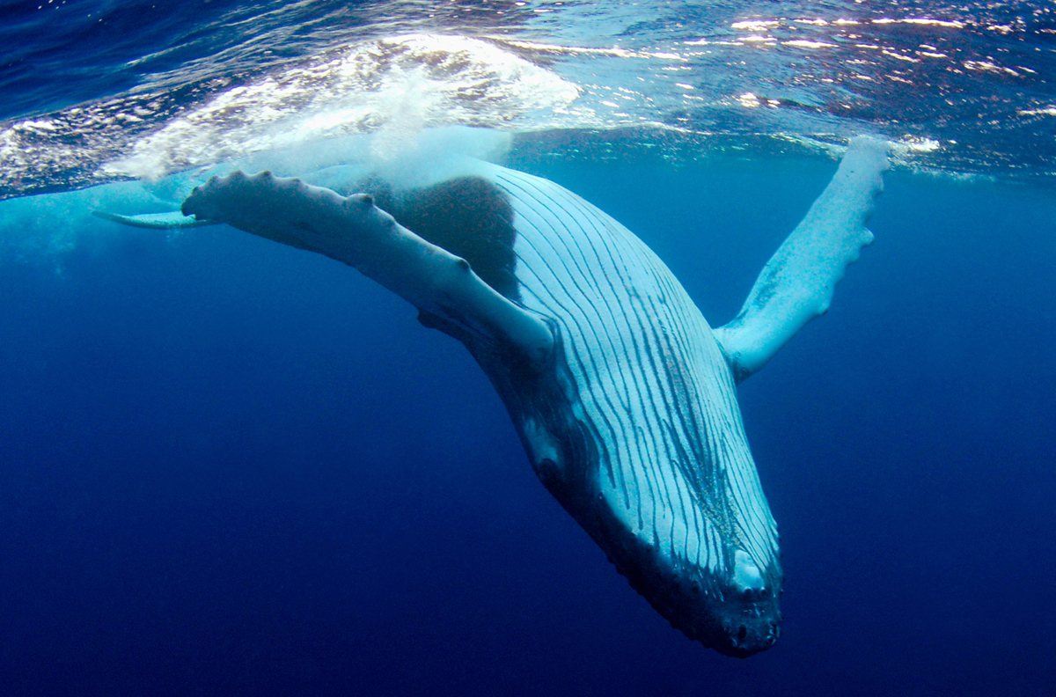
sounded
verb- to plunge downward or dive, as a whale

